Slide 1


CS371: Artificial Intelligence
July – November 2020
Chapter – 4
Reasoning
Devang Patel Institute of Advance Technology and Research

Slide 2
Symbolic Reasoning under uncertainty

Slide 3
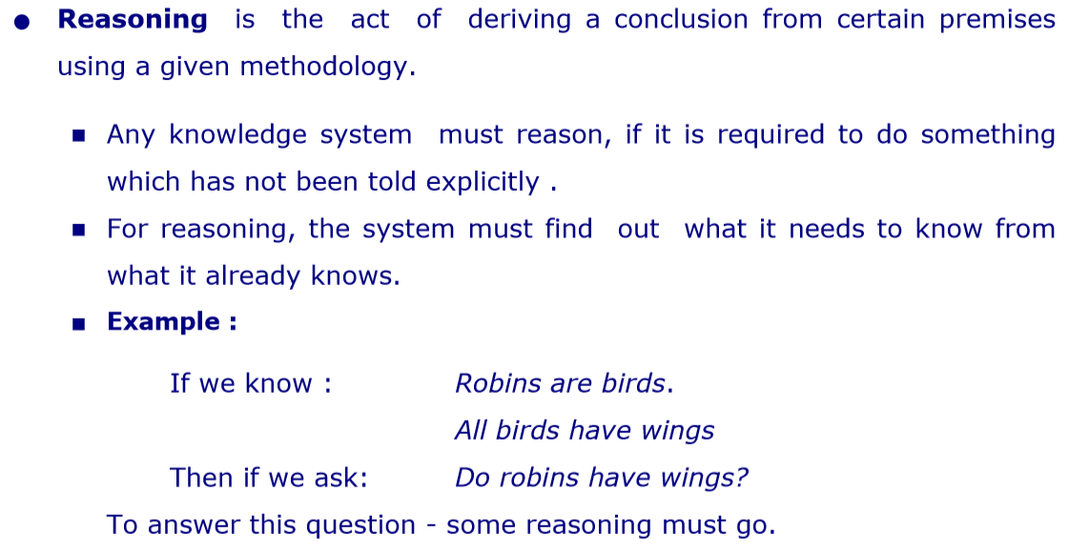


Slide 4
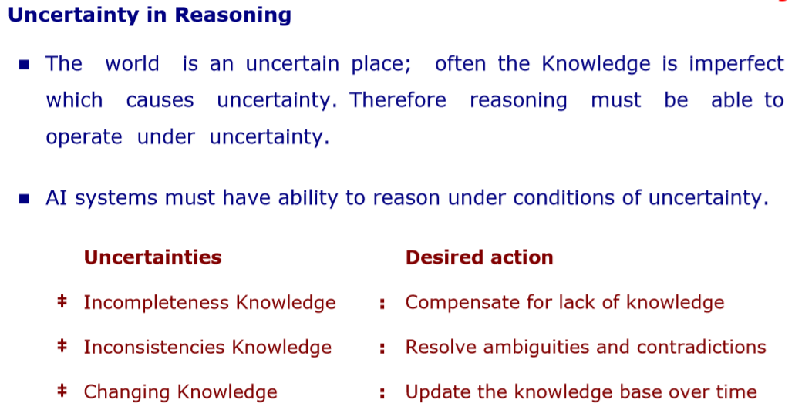

Slide 5
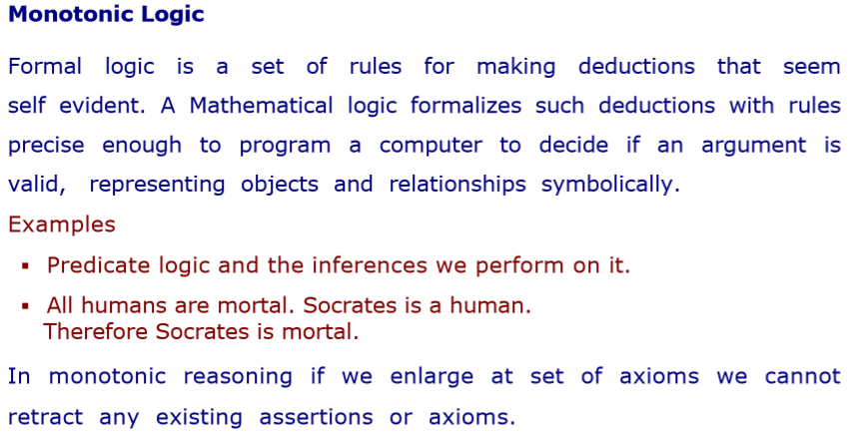
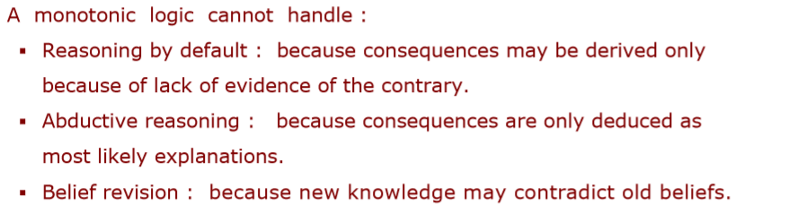

Slide 6

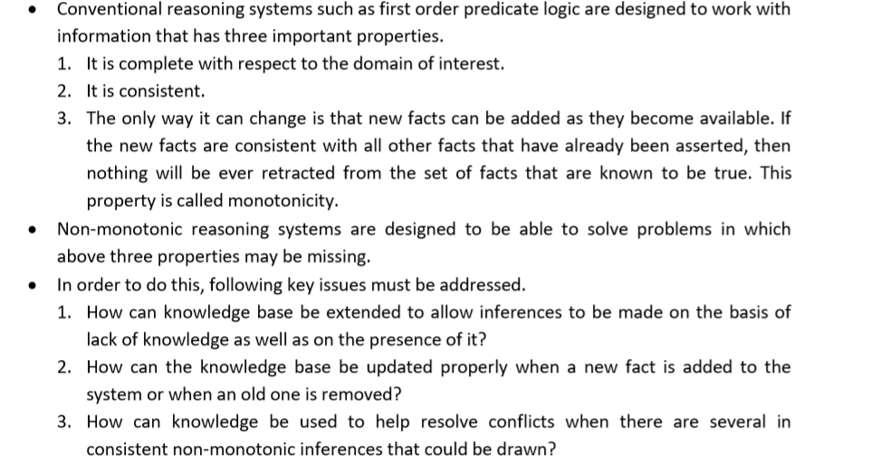

Slide 7
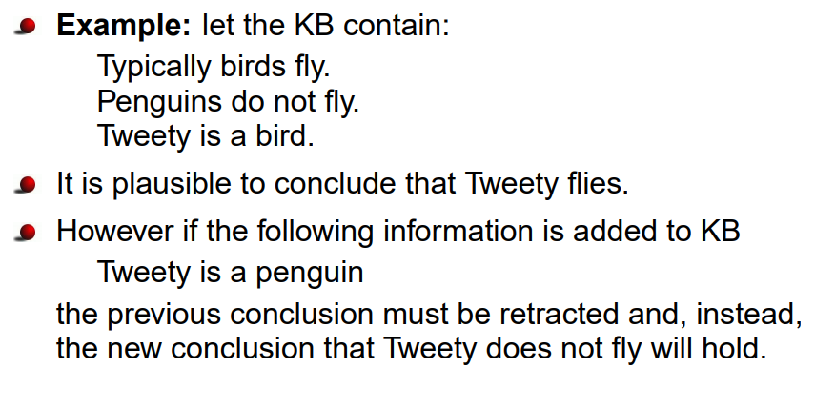

Slide 8
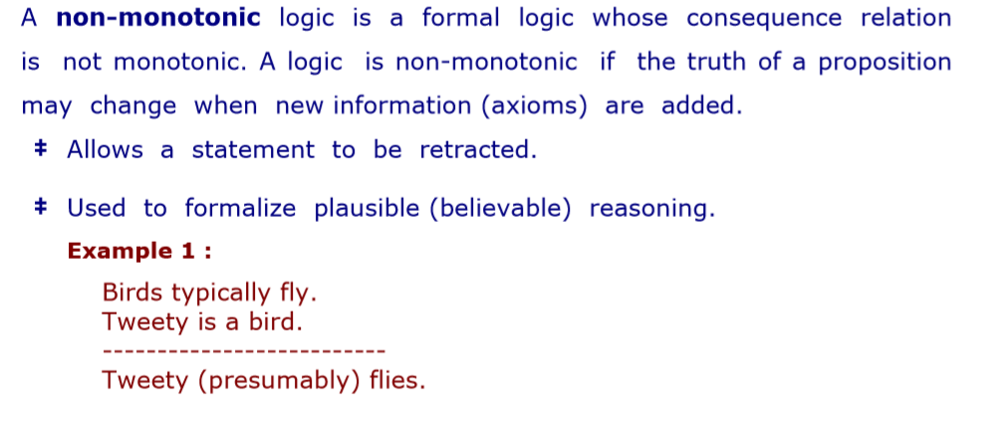

Slide 9
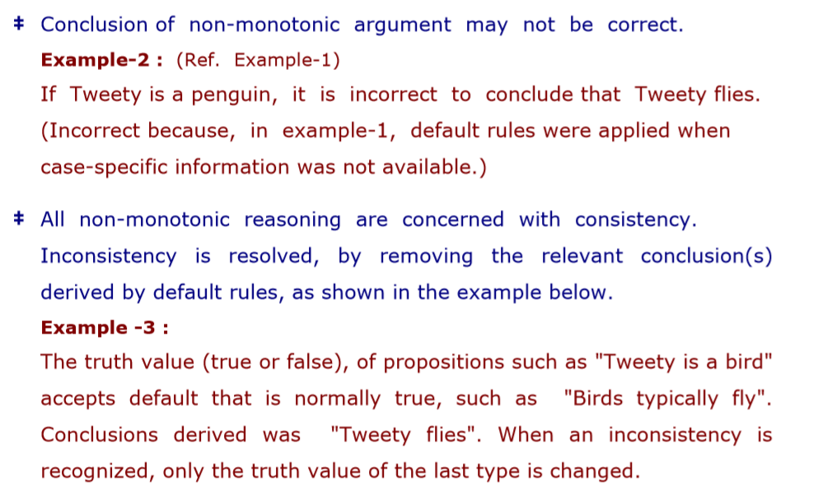

Slide 10
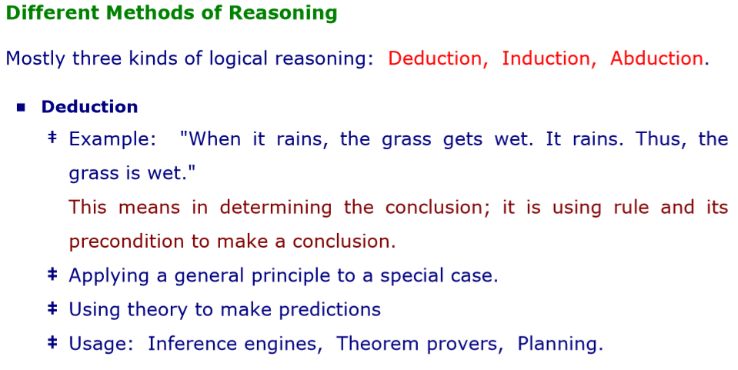

Slide 11
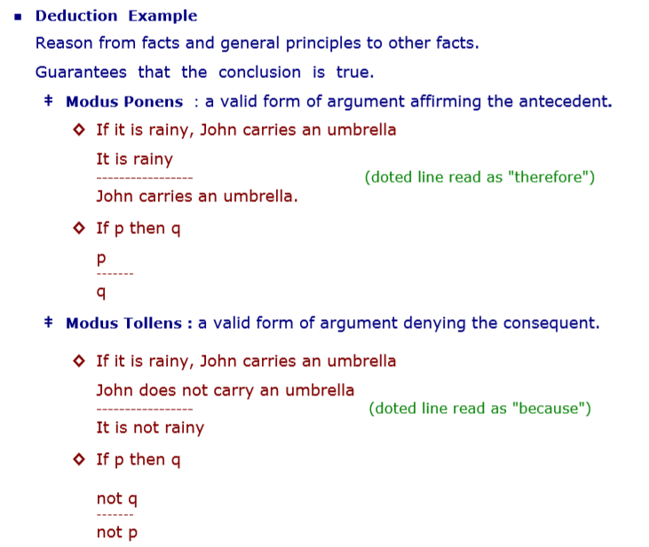

Slide 12
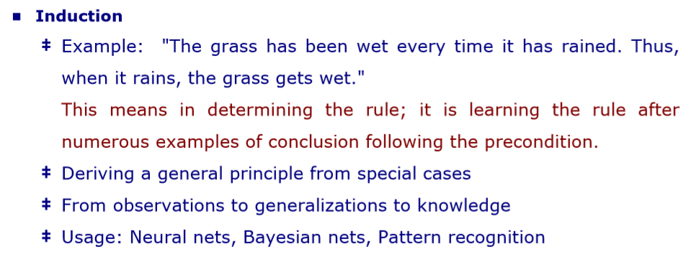

Slide 13
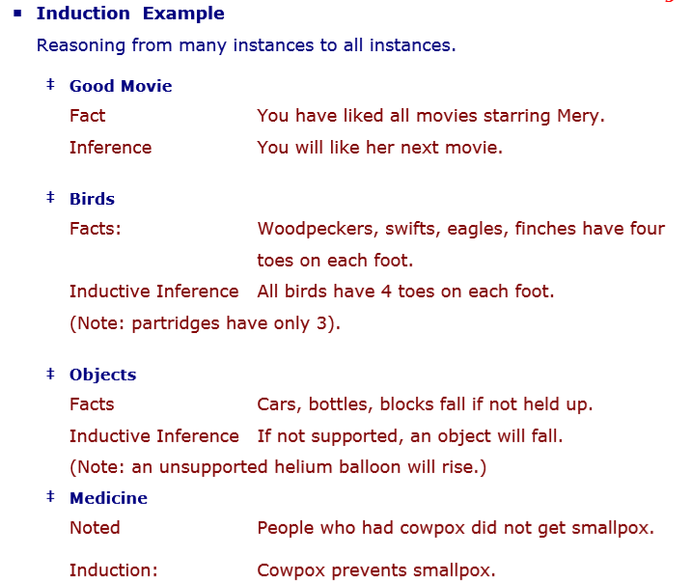

Slide 14
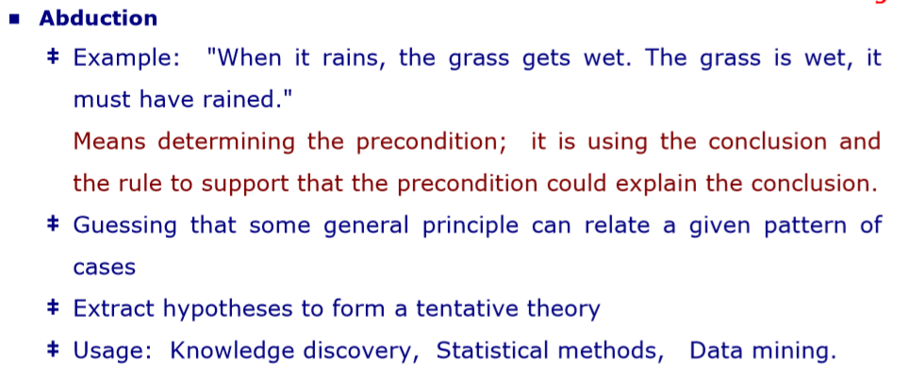

Slide 15
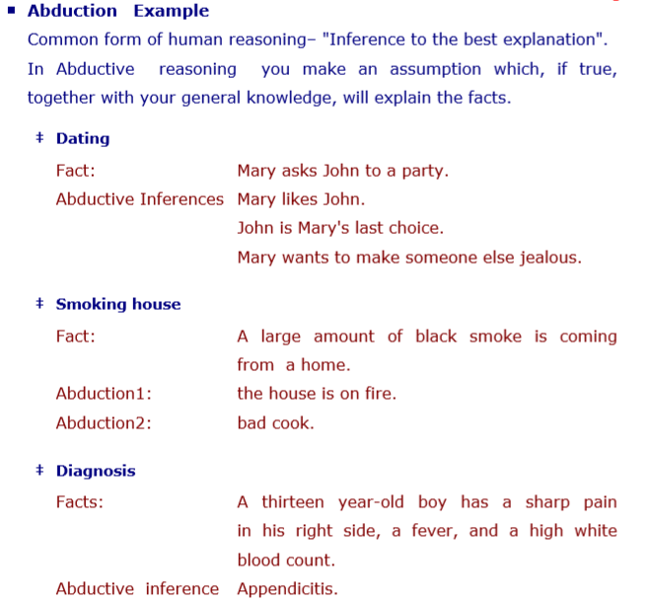

Slide 16
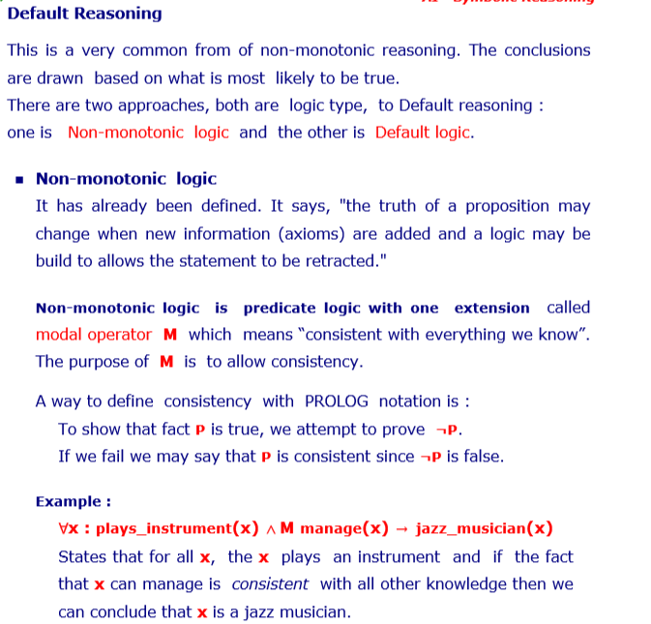

Slide 17
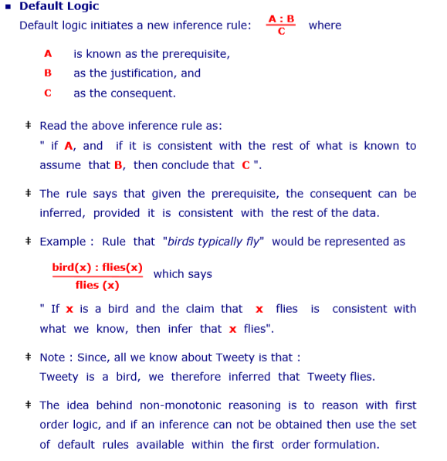

Slide 18
Statistical Reasoning
Artificial Intelligence
Story so far
  We have described several representations techniques that can be used to model belief systems in which, at any given point in time, a particular fact is believed to be true, believed to be false or not considered to be either.
  But for some kinds, it is useful to be able to describe beliefs that are not certain but for which there is some supporting evidence.
    E.g. – Problems that contain genuine randomness. E.g. Card Games
      Problems that could, in principle be modeled using the techniques that we used in uncertainty.
  For such problems, statistical measures may serve a very useful function as summaries of the world; rather than looking for all possible exceptions we can use a numerical summary that tells us how often an exception of some sort can be expected to occur.

Slide 19
Statistical Reasoning
Artificial Intelligence
  Probability & Bayes Theorem
  An important goal for many problem solving systems is to collect evidence as the system goes along and to modify its behavior on the basis of evidence.
  To model this behavior we need a statistical theory of evidence. Bayesian statistics is such a theory.
  The fundamental notion of Bayesian statistics is that of condition probability.

Slide 20
Statistical Reasoning
Artificial Intelligence
  Probability & Bayes Theorem
  Read the expression as the probability of Hypothesis H given that we have observed evidence E.
  To compute this, we need to take into account the prior probability of H( the probability that we would assign to H if we had no evidence)
  & the extent to which E provides evidence of H.
  To do this we need to define a universe that contains an exhaustive, mutually exclusive set of Hi’s , among which we are trying to discriminate

Slide 21
Statistical Reasoning
Artificial Intelligence
  Probability & Bayes Theorem
  P(Hi\E) – The probability that hypothesis Hi is true given evidence E
  P(E\Hi) – The probability that we will observe evidence E given that hypothesis i is true.
  P(Hi) – The a priori probability that hypothesis I is true in the absence of any specific evidence. These probabilities are called prior probabilities or prlors.
  K = The number of possible hypothesis.
  Bayers’ theorem states then that
  P(Hi\E)=P(E\Hi).P(Hi)
  ∑ P(E\Hn).P(Hn) [for n=1 to k]

Slide 22
Statistical Reasoning
Artificial Intelligence
  Probability & Bayes Theorem
  mineral example - PROSPECTOR is a program which has been used successfully to help locate deposits of several minerals.
  The key to use Bayes’ theorem as a basis for uncertain reasoning is to recognize exactly what it says.
  When we say P(A\B), we are describing the condition probability of A given that the only evidence we have is B.
  It there is also other relevant evidence, then it must also be considered.
  Spots, Fever & Measles Example.

Slide 23
Statistical Reasoning
Artificial Intelligence
  Probability & Bayes Theorem
  The Bayes’ theorem is intractable for several reasons :
  The knowledge acquisition problem is insurmountable; too many probabilities have to be provided. And there are substantial evidence that people are very bad probability estimators.
  The space that would be required to store all the probabilities is too large.
  The time required to compute the probabilities is too large.
  Even if we have the above mentioned problems the theorem is still very useful for the uncertain system. Various mechanisms to use it have been developed. Some of them are
  Attaching certainty factors to rules
  Bayesian Networks
  Dempster-Shafer Theory

Slide 24
Statistical Reasoning
Artificial Intelligence
  Certainty Factors & Rule Based Systems
  In this we are trying describe a practical way of compromising on a pure Bayesian System.
  We will use MYCIN as an example here which uses LISP and acts as an Expert System.
  MYCIN uses the rules to reason Backwards to the clinical data available from its goal of finding significant disease-causing organisms. Each rules has a certainty attached to it. Once the identities of the organism is found , it then attempts to select a therapy by which the disease can be treated.

Slide 25
Statistical Reasoning
Artificial Intelligence
  Certainty Factors & Rule Based Systems
  A certainty factor(CF[h,e] )is defined in terms of two components :
  MB[h,e] - a measure (between 0 and 1) of belief in hypothesis “h” given the evidence “e”. MB measures the extend to which the evidence supports the hypothesis. It is zero if the evidence fails to support the hypothesis.
  MD[h,e] - a measure (between 0 and 1) of disbelief in hypothesis “h” given the evidence “e”. MD measures the extend to which the evidence supports the negation of the hypothesis. It is zero if the evidence support the hypothesis.
  CF[h,e] = MB[h,e]- MD[h,e]

Slide 26
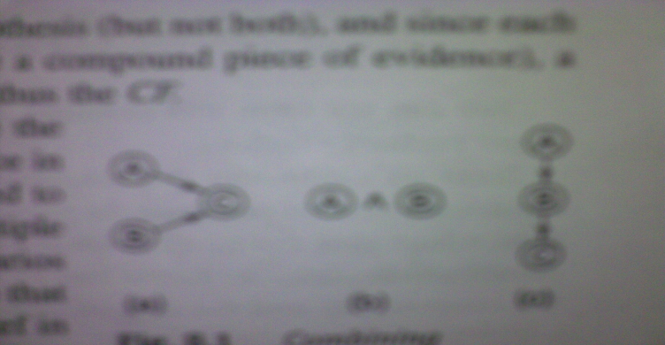
Statistical Reasoning
Artificial Intelligence
  Certainty Factors & Rule Based Systems
  Since any particular piece of evidence either supports or denies a Hypothesis( but not both) and since each MYCIN rule corresponds to one piece of evidence ( can be compound piece of evidence) a single number suffices for each rule to define both MB and MD and thus the CF.
  The CF’s are provided by the experts who write the rules. They reflect the experts assessments of the strength of the evidence in support of the Hypothesis.
  At times CFs need to be combined to reflect the operation of multiple pieces of evidence and multiple rules applied to a problem.
  Various combinations

Slide 27
Statistical Reasoning
Artificial Intelligence
  Certainty Factors & Rule Based Systems
  The combining functions should satisfy the following properties :
  Since the order in which evidence is collected is arbitrary, the combining functions should be commutative and associative.
  Until certainty is reached, additional confirming evidence should increase MB and similarly for disconfirming evidence , MD.
  If uncertain inference are chained together, then the result should be less certain that either of the inferences alone.
  By use of CFs we reduce the complexity of a Bayesian reasoning system by making some approximations to the formalism.

Slide 28
Statistical Reasoning
Artificial Intelligence
  Bayesian Networks
  It is an alternative approach to what we did in the previous section.
  The idea is to describe the real world, it is not necessary to use a huge joint probability table in which we list the probabilities of all combinations, because most events are independent of each other, there is no need to consider the interactions between them.
  We will use a more local representation in which we will describe clusters of events that interact.
Rain
Rainy Season
Sprinkler
Wet
Sprinkler
Rain
Wet

Slide 29
Statistical Reasoning
Artificial Intelligence
  Bayesian Networks
  Introduction of the new node, that is the Bayesian Network Structure is to make things clear.
  The Graph in figure B is known as DAG – Directed Acyclic Graph that represents causality relationships among the variables. However , we need more information. In particular, we need to know , for each value of a parent node, what evidence is provided about the values that the child node can take on. We create a probability table for that]
  When the most genuine reasoning does not seem true then we need to use an undirected graph in which the arcs can be used to transmit probabilities in either direction, depending upon where the evidence came from.
  We have to ensure that there is no cycle that exists between the evidences.

Slide 30
Statistical Reasoning
Artificial Intelligence
  Bayesian Networks
  Three algorithms are available for doing these computations
  A message-passing method.
  A cliché triangulation method.
  A variety of stochastic algorithms.

Slide 31
Statistical Reasoning
Artificial Intelligence
  Bayesian Networks
  The message-passing approach is based on the observation that to compute the probability of a node A given what is known about other nodes in the network. It is necessary to know three things.
  The total support arriving at A from its parents.
  The total support arriving at A from its children.
  The entry in the fixed condition probability matrix that relates A to its causes.
  Cliché triangulation method. Explicit arcs are introduced between pair of nodes that share a common descendent.
  Stochastic Algorithm or Randomized Algorithms – The idea is to shield a given node probabilistically from most of the other nodes in the network. These algorithms run faster but may not give correct results.

Slide 32
Statistical Reasoning
Artificial Intelligence
  Dempster-Shafer Theory
  Till now, we have talked about individual propositions and assign to each of them a single number of the degree of belief that is warranted given the evidence.
  In Dempster-Shafer Theory we consider sets of propositions and assign to each of them an interval in which the degree of belief must lie.
  [Belief,Plausibility]
  Belief denoted as Bel measures the strength of the evidence in favor of a set of propositions. It ranges from 0( no evidence) to 1(definite certainty)
  Plausibility (PI) is PI(s) = 1- Bel(s)
  It also ranges from 0 to 1 and measures the extent to which evidence in favor of (not)s leaves room for belief is s.

Slide 33
Statistical Reasoning
Artificial Intelligence
  Dempster-Shafer Theory
  In short if we have certain evidence in favor of (not)s, then Bel(not(s)) will be 1 and Pl(s) will be 0. this also tells us that the only possible value for Bel(s) is also 0.
  The interval thing we are talking about, also tells about the amount of information we have. If we have no evidence we say that the hypothesis is in the range of [0,1]. As we gain more evidence , this interval can be expected to shrink, and giving confident answers.
  This is different from Bayesian as in that we would probably begin by distributing the probability among the hypotheses (.33 in case of 3) and we may end up with the same probability at the end, but in Dempster we state that we have no information at the start and everything is in the range of 0 to 1.

Slide 34
Statistical Reasoning
Artificial Intelligence
  Dempster-Shafer Theory
  Let’s take an example where we have some mutually exclusive hypothesis.
  Allergy, Flu, Cold, Pneumonia , The set is denoted by Ɵ
  We want to attach some measure of belief to elements of Ɵ.
  But all evidence are not directly supportive of individual elements.
  The key function we use here is a Probability Density Function, denoted by m.
  The function m, is not only defined for elements of Ɵ but also all subsets of it.
  The quantity m(p) measures the amount of belief that is currently assigned to exactly to the set “p” of hypothesis.

Slide 35
Statistical Reasoning
Artificial Intelligence
  Dempster-Shafer Theory
  If Ɵ contains n elements then there are 2^{n} subsets of Ɵ.
  We must assign m so that the sum of all the m values assigned to subsets of Ɵ is 1.
  At the beginning we have m as under
  Ɵ = (1.0)
  If we get an evidence of .6 magnitude that the correct diagnosis is in the set {Flu,Cold,Pneu}then
  {Flu,Cold,Pneu}= (0.6)
  Ɵ = (0.4)
  This does not lead us anywere, we need more information

Slide 36
Statistical Reasoning
Artificial Intelligence
  Dempster-Shafer Theory
  Now to move further, lets consider we have two belief function m1 and m2. Let X be the set of subsets of Ɵ to which m1 assigns a nonzero value and let Y be the corresponding set for m2. We define m3, as a combination of the 2.
  Pg.182 for the formula to calculate m3.
  m1= { F,C,P} = 0.6
  Ɵ = 0.4
  m2= {A,F,C} =0.8
  Ɵ= 0.2

Slide 37
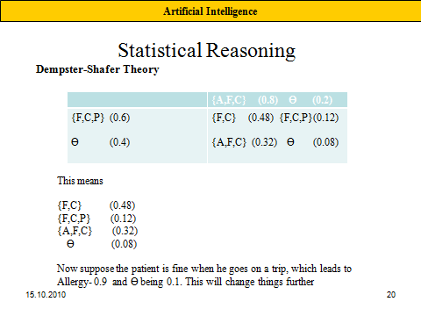

Slide 38
Statistical Reasoning
Artificial Intelligence
  Fuzzy Logic
  the only change is that it allows us to represent set memberships as a possibility distribution as shown in 1st figure, in the other there is no range, either one is tall or not tall.
  In the standard Boolean definition for tall people is either tall or not and there must be a specific height that defines the boundary.
  Once set membership has been redefined in this way, it is possible to define a reasoning system based on the techniques for combining distributions.
  Such methods have been used in control systems for devices like trains and washing machines.

